Slide 1
Introduction to Python

Slide 2
What is python?
Python is an interpreted, object-oriented, high-level, general-purpose programming language
Python is relatively simple, so it's easy to learn since it requires a unique syntax that focuses on readability. Developers can read and translate Python code much easier than other languages.
Python is more productive than conventional languages, such as C and Java, for programming problems involving string manipulation and search in a dictionary, and determined that memory consumption was often better.

Slide 3
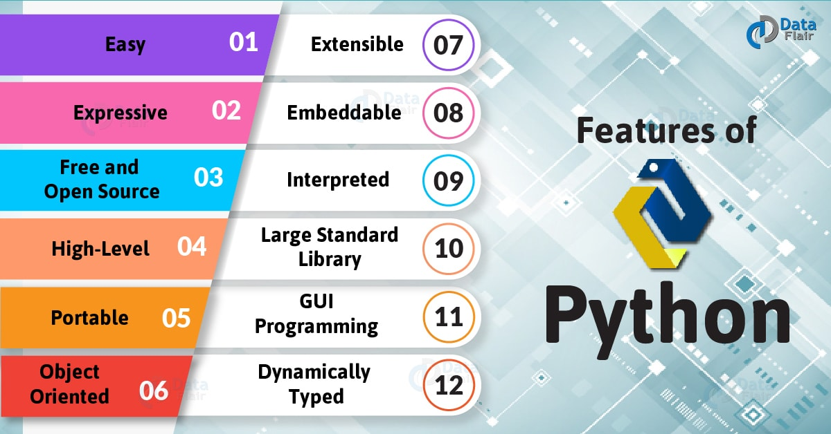

Slide 4
Popularity
Third most popular language in the TIOBE index
Most popular language used in data science, next to R.
Google adopted Python heavily back in 2006

Slide 5
Versatility
Web development
Data analysis
Machine learning & AI
Scripting
Game development
Desktop applications
Automation
Networking
Text & image processing

Slide 6
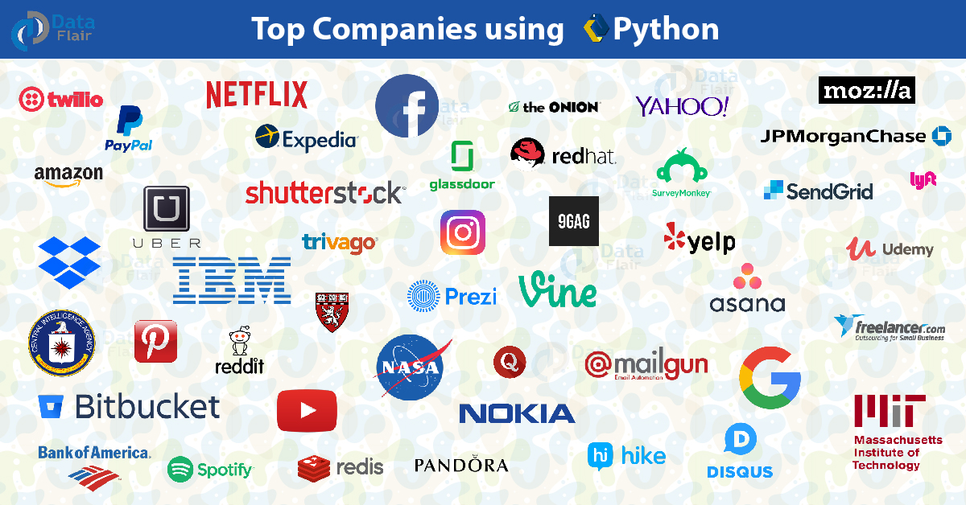

Slide 7
Environment setup
Most of the operating systems include Python as a standard component.
It ships with most Linux distributions, AmigaOS 4, FreeBSD (as a package), NetBSD, OpenBSD (as a package) and macOS and can be used from the command line (terminal).
In windows python can be installed using python installer from https://www.python.org/

Slide 8
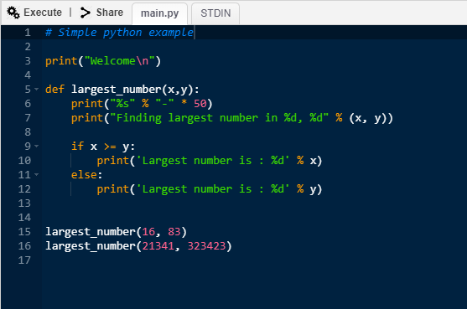
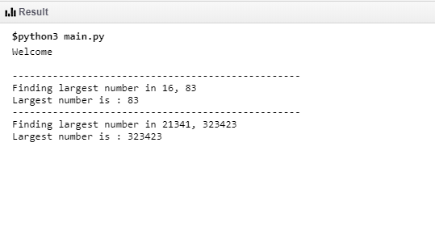
Python syntax
Python uses whitespace (spaces and tabs) to define program blocks whereas other languages like C, C++ use braces ({}) to indicate blocks of codes for class, functions or flow control. The number of whitespaces (spaces and tabs) in the indentation is not fixed, but all statements within the block must be the indented same amount.

Slide 9

Installing python packages
Python packages are installed using pip (python package manager)
PyPI (python package index) is the repository for python packages

Slide 10
Resources
Since Python is open source and used by many popular organizations, there are lots of plug-ins, frameworks ready to use for many different purposes.
For example, Google provides various python libraries for developers to integrate & work with OR-tools, tensorflow, Dialogflow, gcloud etc.
There is large community of developers for python, So in case of any problem we could get help easier.

Slide 11
Popular Python web frameworks
Django
Flask
Sanic
Web2py

Slide 12
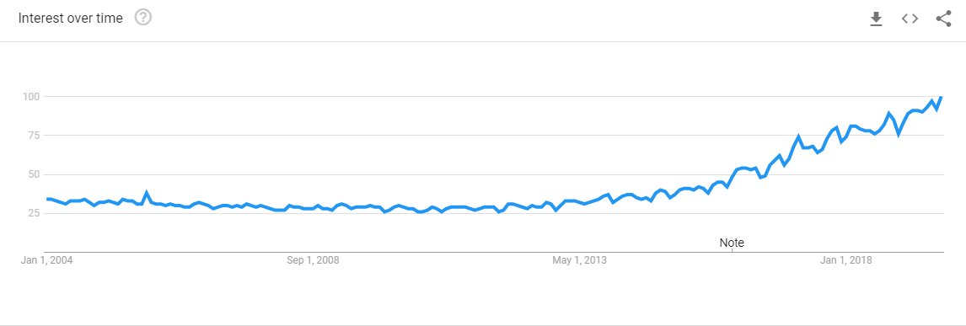
Python’s growth
Google search trends

Slide 13
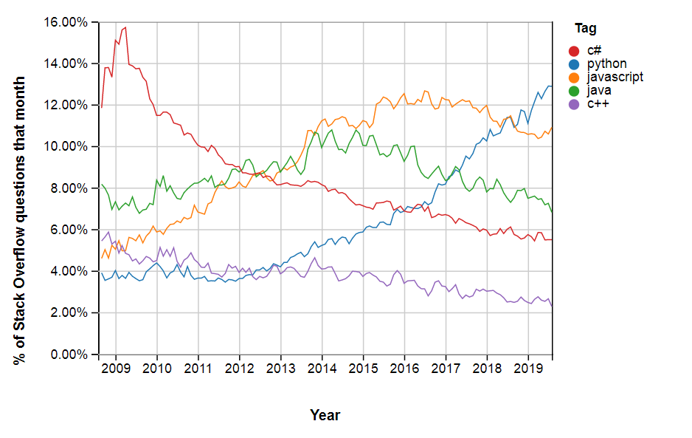
Stack overflow trends

Slide 14
References
https://en.wikipedia.org/wiki/Python_(programming_language)
https://www.pythonforbeginners.com/learn-python/what-is-python/
https://beginnersbook.com/2018/01/introduction-to-python-programming
https://realpython.com/installing-python/
https://www.python.org/
https://trends.google.com/trends
https://insights.stackoverflow.com
https://data-flair.training/blogs/features-of-python/

